Slide 1
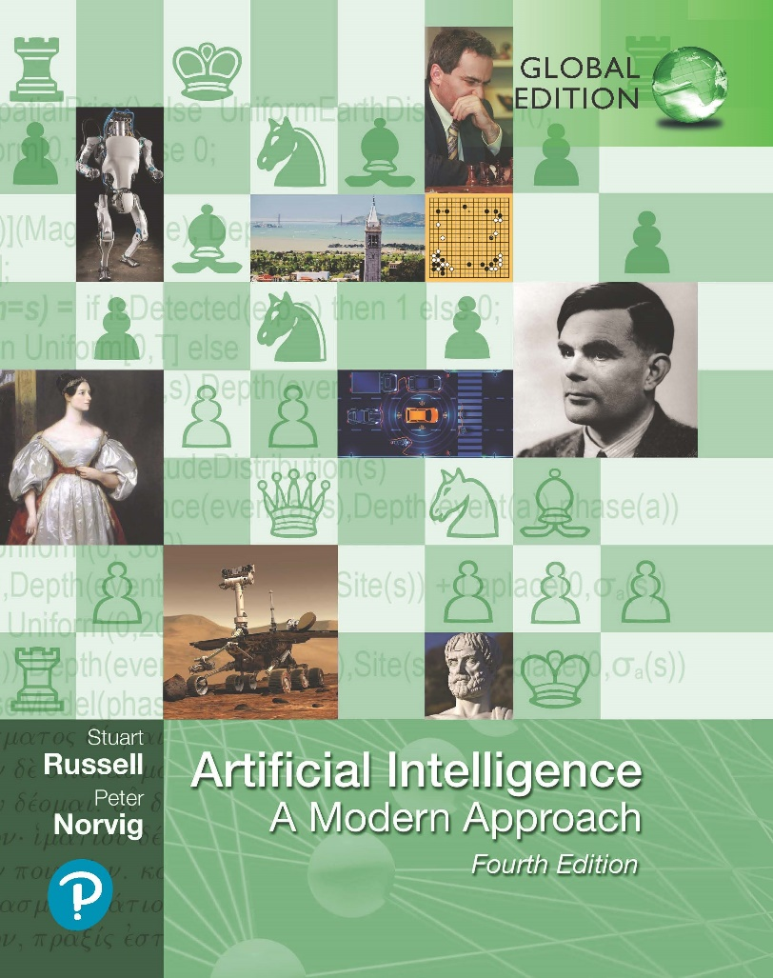
Artificial Intelligence: A Modern Approach
Fourth Edition, Global Edition
Chapter 21
Learning Probabilistic Models
© 2022 Pearson Education Ltd.

Slide 2
Outline
Statistical Learning
Learning with Complete Data
Learning with Hidden Variables: The EM Algorithm

Slide 3
Full Bayesian learning
View learning as Bayesian updating of a probability distribution over the hypothesis space
H is the hypothesis variable, values h₁, h₂, . . ., prior P(H)
jth observation d_{j} gives the outcome of random variable D_{j}
training data d = d₁, . . . , d_{N}
Given the data so far, each hypothesis has a posterior probability:
P (h_{i}|d) = αP (d|h_{i})P (h_{i})
where P (d|h_{i}) is called the likelihood
Predictions use a likelihood-weighted average over the hypotheses:
P(X|d) = Σ_{i} P(X|d, h_{i})P (h_{i}|d) = Σ_{i} P(X|h_{i})P (h_{i}|d)
No need to pick one best-guess hypothesis!

Slide 4









Example
Suppose there are five kinds of bags of candies: 10% are h₁: 100% cherry candies
20% are h₂: 75% cherry candies + 25% lime candies 40% are h₃: 50% cherry candies + 50% lime candies 20% are h₄: 25% cherry candies + 75% lime candies 10% are h₅: 100% lime candies
Then we observe candies drawn from some bag:
What kind of bag is it? What flavour will the next candy be?

Slide 5
Posterior probability of hypotheses
1
P(h₁ | d) P(h₂ | d) P(h₃ | d) P(h₄ | d) P(h₅ | d)
Posterior probability of hypothesis
0.8
0.6
0.4
0.2
0
0
2
4 6
Number of samples in d
8
10

Slide 6
Prediction probability
1
0.9
0.8
0.7
0.6
0.5
0.4
P(next candy is lime | d)
0
2
4 6
Number of samples in d
8
10

Slide 7
MAP approximation
Summing over the hypothesis space is often intractable
(e.g., 18,446,744,073,709,551,616 Boolean functions of 6 attributes)
Maximum a posteriori (MAP) learning: choose h_{MAP} maximizing P (h_{i}|d)
I.e., maximize P (d|h_{i})P (h_{i}) or log P (d|h_{i}) + log P (h_{i})
Log terms can be viewed as (negative of)
bits to encode data given hypothesis + bits to encode hypothesis This is the basic idea of minimum description length (MDL) learning
For deterministic hypotheses, P (d|h_{i}) is 1 if consistent, 0 otherwise
⇒ MAP = simplest consistent hypothesis (cf. science)

Slide 8
ML approximation
For large data sets, prior becomes irrelevant
Maximum likelihood (ML) learning: choose h_{ML} maximizing P (d|h_{i})
I.e., simply get the best fit to the data; identical to MAP for uniform prior (which is reasonable if all hypotheses are of the same complexity)
ML is the “standard” (non-Bayesian) statistical learning method

Slide 9
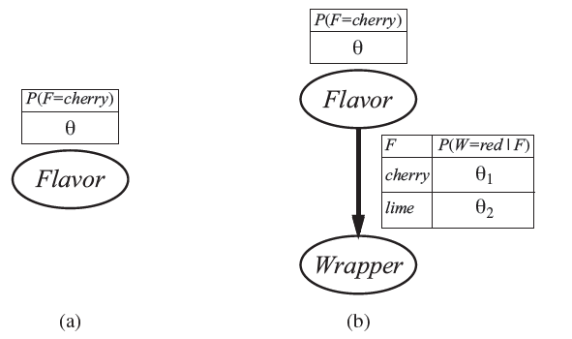
Bayesian Network Model
Bayesian network model for the case of candies with an unknown proportion of cherries and lines.
Model for the case where the wrapper color depends (probabilistically) on the candy flavor.

Slide 10
ML parameter learning in Bayes nets
Bag from a new manufacturer; fraction θ of cherry candies?
Any θ is possible: continuum of hypotheses h_{θ}
θ is a parameter for this simple (binomial) family of models
P(F=cherry )
θ
Flavor
Suppose we unwrap N candies, c cherries and € = N − c limes
These are i.i.d. (independent, identically distributed) observations, so
N
c €
II
P (d|h_{θ}) = P (d |h ) = θ · (1 − θ)
j = 1
j θ
Maximize this w.r.t. θ—which is easier for the log-likelihood:
N
L(d|h_{θ}) = log P (d|h_{θ}) = _{j} ^{L}₌ ₁ log P (d_{j}|h_{θ}) = c log θ + € log(1 − θ)
c €
θ 1 − θ c + € N
dL(d|h )
c c
=
θ
=
− = 0 ⇒ θ =
dθ
Seems sensible, but causes problems with 0 counts!

Slide 11
Multiple parameters
Red/green wrapper depends probabilistically on flavor:
P(F=cherry )
θ
Likelihood for, e.g., cherry candy in green wrapper:
Flavor
P (F = cherry , W = green |h_{θ,θ1,θ2})
F | P(W=red | F)
cherry | 1
lime | 2
= P (F = cherry |h )P (W = green |F = cherry , h )
= θ · (1 − θ₁)
θ
θ,θ ,θ
θ,θ ,θ
1 2
1 2
θ
N candies, r_{c} red-wrapped cherry candies, etc.:
Wrapper
c € r g
r
g
P (d|h ) = θ (1 − θ) · θ (1 − θ ) · θ (1 − θ )
θ,θ ,θ
c c
1 2
1
1
2 2
L = [c log θ + f log(1 − θ)] + [r_{c} log θ₁ + g_{c} log(1 − θ₁)] + [r log θ₂ + g log(1 − θ₂)]

Slide 12
Multiple parameters contd.
Derivatives of L contain only the relevant parameter:
∂L c
€
c
= − = 0 ⇒ θ =
∂θ θ 1 − θ c + €
∂L
r g_{c}
r_{c}
c
= −
= 0
⇒ θ =
∂θ₁ θ₁ 1 − θ₁
g€
1
r_{c} + g_{c}
∂L
r
€
r€
= − = 0 ⇒ θ
2
=
∂θ₂ θ₂ 1 − θ₂ r€ + g€
With complete data, parameters can be learned separately

Slide 13

Naive Bayes Models
Assuming Boolean variables, the parameters are
With observed attribute values x₁, ... , x_{n}, the probability of each class is given by
A deterministic prediction can be obtained by choosing the most likely class
The method learns fairly well but not as well as decision-tree learning; this is
presumably because the true hypothesis-which is a decision tree-is not representable exactly using a naive Bayes model.
Naive Bayes learning turns out to do surprisingly well in a wide range of applications; the boosted version
Scales well to large problems with n Boolean attributes there are just 2n + 1 parameters

Slide 14
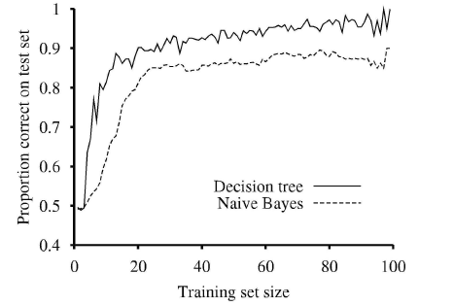
Naive Bayes Models
The learning curve for naive Bayes learning applied to the restaurant problem from chapter 18. Compared with decision tree learning.

Slide 15
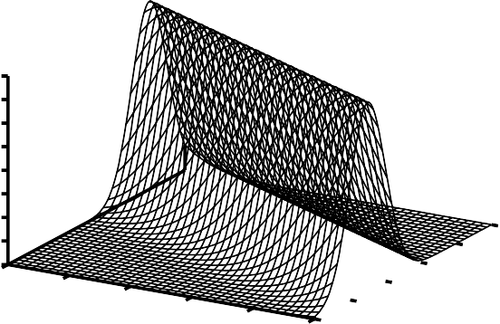
Example: linear Gaussian model
1
0.8
P(y |x) 4
3.5
3
2.5
2
1.5
1
0.5
0.6
y
0.4
0.8
1
0.2
0₀
0.2
0.4
0.6
y
0.4
x
0.6
0.8
0
0.2
0
1
0 0.1 0.2 0.3 0.4 0.5 0.6 0.7 0.8 0.9 1
x
1
(y−(θ x+θ ))
2
Maximizing P (y|x) = √ e
−
1 2
2σ²
w.r.t. θ₁, θ₂
2πσ
N
2
L
= minimizing E = (y_{j} − (θ₁x_{j} + θ₂))
j = 1
That is, minimizing the sum of squared errors gives the ML solution for a linear fit assuming Gaussian noise of fixed variance

Slide 16

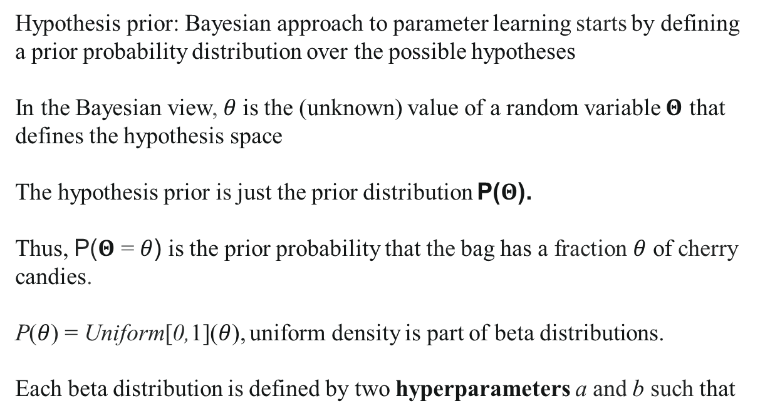
Naive Bayes Models
Bayesian parameter learning
Hypothesis prior: Bayesian approach to parameter learning starts by defining a prior probability distribution over the possible hypotheses
In the Bayesian view, $θ$is the (unknown) value of a random variable $Θ$ that defines the hypothesis space
The hypothesis prior is just the prior distribution P($Θ$).
Thus, P($Θ$ = $θ$) is the prior probability that the bag has a fraction $θ$ of cherry candies.
P($θ$) = Uniform[0,1]($θ$), uniform density is part of beta distributions.
Each beta distribution is defined by two hyperparameters a and b such that

Slide 17
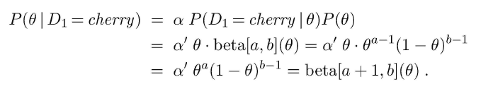



Naive Bayes Models
Bayesian parameter learning

Slide 18
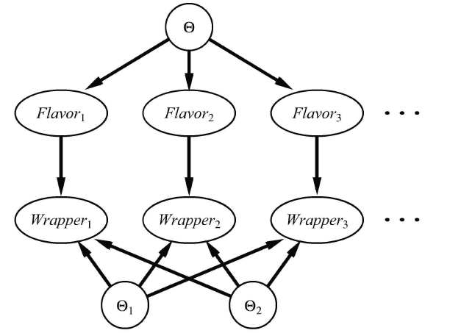
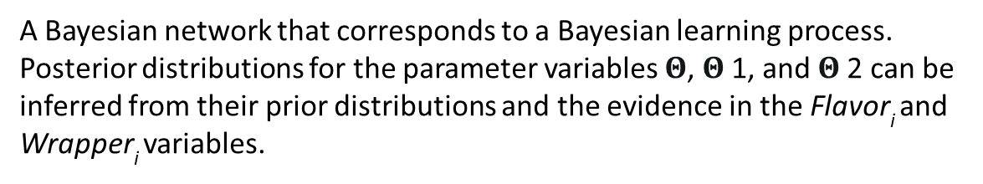
Naive Bayes Models
Bayesian parameter learning
A Bayesian network that corresponds to a Bayesian learning process. Posterior distributions for the parameter variables $Θ$, $Θ$1, and $Θ$2 can be inferred from their prior distributions and the evidence in the Flavor_{i} and Wrapper_{i} variables.

Slide 19

Naive Bayes Models
Density estimation with nonparametric models
k-nearest neighbors
to estimate the unknown probability density at a query point x, we can simply measure the density of the data points in the neighborhood of x.
User kernel functions

Slide 20
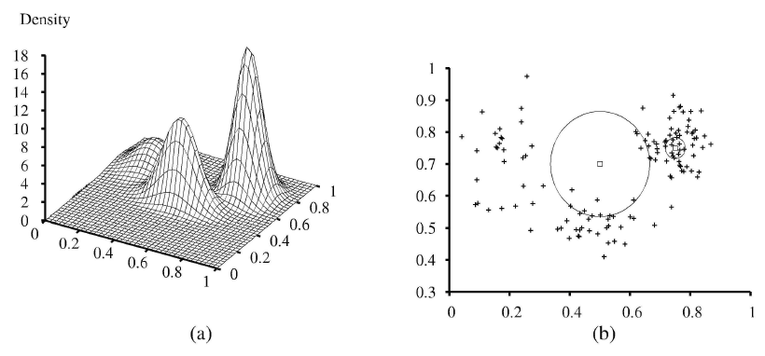
Naive Bayes Models
A 3D plot of the mixture of Gaussians
A 128- point sample of points from the mixture, together with two query points (small squares) and their IO-nearest-neighborhoods (medium and large circles).

Slide 21
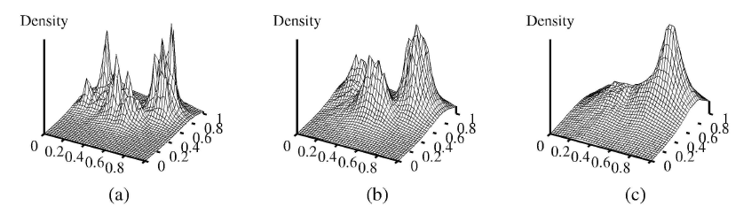
Naive Bayes Models
Density estimation using k-nearest-neighbors, for k= 3, 10, and 40 respectively.
k = 3 is too spiky, 40 is too smooth, and 10 is just about right.
The best value for k can be chosen by cross-validation

Slide 22
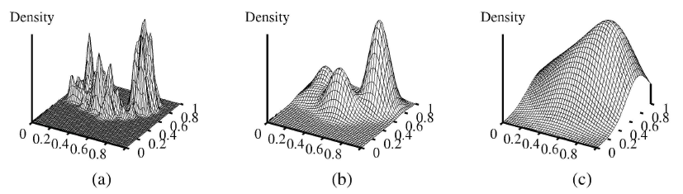
Naive Bayes Models
Kernel density estimation using Gaussian kernels with $w$ = 0.02, 0.07, and 0.20 respectively. w = 0.07 is about right.

Slide 23
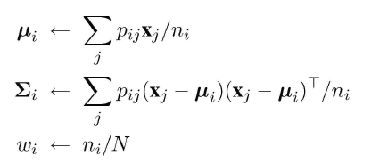
Learning With Hidden Variables: The EM Algorithm
Many real-world problems have hidden variables (sometimes called latent variables)
Expectation-maximization helps with hidden variables
infer the probability that each data point belongs to each component.
refit the components to the data, where each component is fitted to the entire data set with each point weighted by the probability that it belongs to that component.
The process iterates until convergence
For the mixture of Gaussians, initialize the mixture-model parameters arbitrarily and iterate the E-step & M-step
Observations: the log likelihood for the final learned model slightly exceeds that of the original model & EM increases the log likelihood of the data at every iteration.

Slide 24
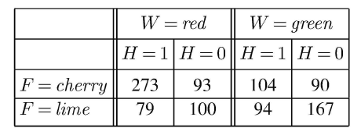
Learning With Hidden Variables: The EM Algorithm
Learning Bayesian networks with hidden variables
Example: a situation in which there are two bags of candies that have been mixed together.
Candies are described by three features: in addition to the Flavor and the Wrapper, some candies have a Hole in the middle and some do not.
The distribution of candies in each bag is described by a naive Bayes model: the features are independent, given the bag, but the conditional probability distribution for each feature depends on the bag.

Slide 25



Learning With Hidden Variables: The EM Algorithm
Learning Bayesian networks with hidden variables
The expected count of $\hat{N}$ ( Bag = l) is the sum, over all candies, of the probability that the candy came from bag 1:
using Bayes' rule and applying conditional independence
The expected count of cherry candies from bag 1 is given by
The update is given by the normalized expected counts as follows

Slide 26
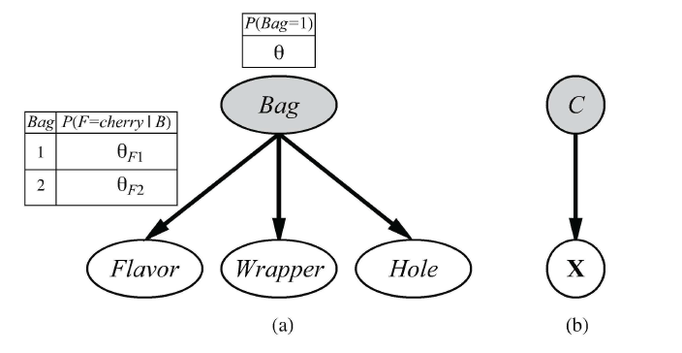
Learning With Hidden Variables: The EM Algorithm
Learning Bayesian networks with hidden variables
A mixture model for candy. The proportions of different flavors, wrappers, presence of holes depend on the bag, which is not observed.
Bayesian network for a Gaussian mixture. The mean and covariance of the observable variables X depend on the component C.

Slide 27
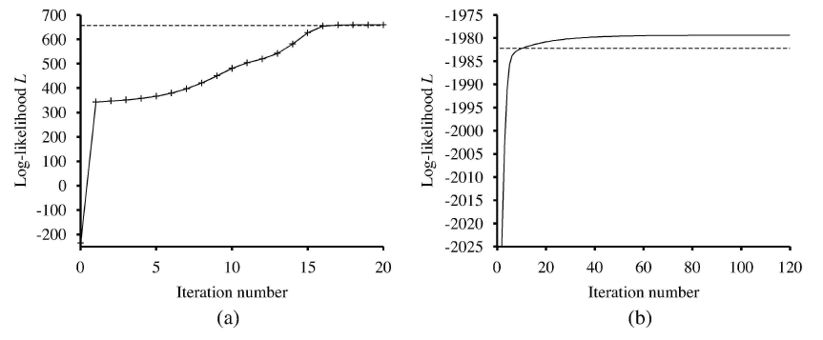
Learning With Hidden Variables: The EM Algorithm
Graphs showing the log likelihood of the data, L , as a function of the EM iteration (a) Graph for Gaussian mixture model (b) Graph for the Bayesian network

Slide 28

Learning With Hidden Variables: The EM Algorithm
Learning hidden Markov models
One application of EM involves learning the transition probabilities in hidden Markov models (HMMs).
A hidden Markov model can be represented by a dynamic Bayes net with a single discrete state variable
Each data point consists of an observation sequence of finite length
transition probability from state i to state j,
calculate the expected proportion of times that the system undergoes a transition to state j when in state i:

Slide 29
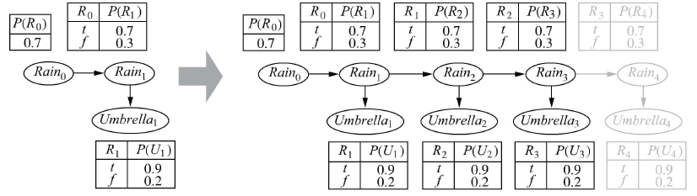
Learning With Hidden Variables: The EM Algorithm
An unrolled dynamic Bayesian network that represents a hidden Markovmodel

Slide 30

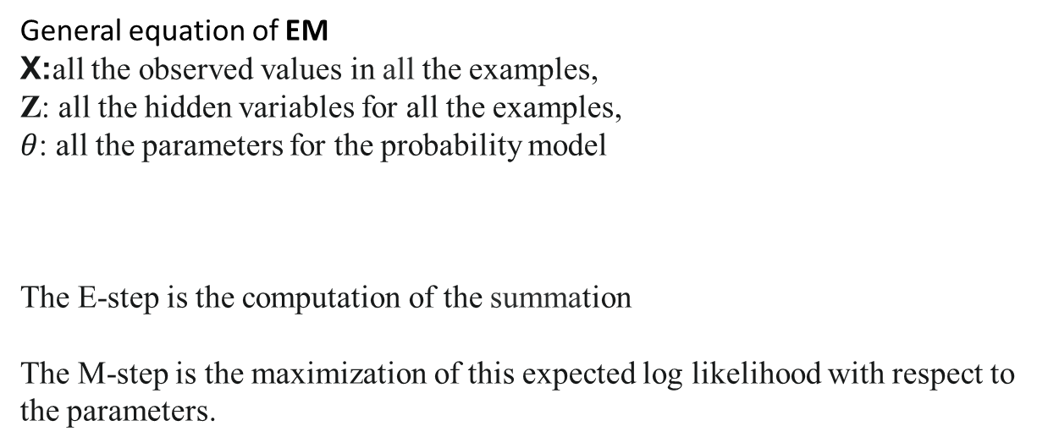
Learning With Hidden Variables: The EM Algorithm
General equation of EM
X:all the observed values in all the examples,
Z: all the hidden variables for all the examples,
$θ$: all the parameters for the probability model
The E-step is the computation of the summation
The M-step is the maximization of this expected log likelihood with respect to the parameters.

Slide 31
Summary
Bayesian learning methods formulate learning as a form of probabilistic inference, using the observations to update a prior distribution over hypotheses.
Maximum a posteriori (MAP) learning selects a single most likely hypothesis given the data.
Maximum-likelihood learning simply selects the hypothesis that maximizes the likelihood of the data; it is equivalent to MAP learning with a uniform prior.
Naive Bayes learning is a particularly effective technique that scales
When some variables are hidden, local maximum likelihood solutions can be found using the EM algorithm
Nonparametric models represent a distribution using the collection of data points.

